Slide 1
College & Career Readiness
Starts in Elementary School
April 11, 2019
Presented
by
Karen Powell – Mission West Counselor
Janet Diaz – Mission Bend Counselor
Tonichia Williams Jackson – Oakland Counselor

Slide 2
This Workshop Covers
What it means to be College & Career Ready
What elementary parents need to know now
Academic Planning
Graduation Plans
Academies
Career & Technical Education
Military Opportunities
Financial Readiness

Slide 3
What Kind of Students Do We Want Leaving Our Schools?
Readers | Writers | Successful
Smart | Clear Communicator | Persistent
Reliable | Appreciative | Willing to give back
Cautious | Risk-taker | Confident
Moral | Spiritually Connected | Competitive
Ability to say no | Problem Solver | Negotiator
Willing to compromise | Friendly | Team Players
Honest | Questioners | Helpful
Effective Listeners | Critical Thinkers | Life-long Learners
Loyal | Responsible | Caring
Analytical | Happy | Physically Healthy
Technologically Competent | Effective | Cooperative

Slide 4
Fort Bend ISD
Profile of Graduate
A Fort Bend ISD Graduate has a rigorous academic foundation, strong character, and is…
…equipped with skills for life.
  Fort Bend ISD graduates exhibit grit and determination in all aspects of life; respect self and others; engage in healthy life choices; are literate and articulate; proficient with technology; and meaningfully and practically apply knowledge in productive ways.
…a servant leader.
  Fort Bend ISD graduates demonstrate confidence while maintaining a humble and kind demeanor; prioritizing the needs of others while accepting responsibility for themselves and are accountable for their own actions; are optimistic; and strive to bring out the best in others.
…an effective communicator.
  Fort Bend ISD graduates communicate clearly both orally and in writing; respectfully and actively listen to others; appropriately engage in courageous conversations; and appropriately adapt their communication style to the audience.

Slide 5
Fort Bend ISD
Profile of Graduate
…a critical thinker.
  Fort Bend ISD graduates are visionary and solutions-oriented problem solvers; are inquisitive and innovative; and have the courage to actively challenge conventional methods in order to improve themselves and the world around them.
…a compassionate citizen.
  Fort Bend ISD graduates are empathetic to their fellow citizens, exhibiting care and concern for others; are inclusive and embrace differences; are culturally aware; actively engage in improving our diverse community; exercise their right to vote; and are dependable, respectful, trustworthy, and self-disciplined.
…a collaborative team member.
  Fort Bend ISD graduates work effectively with others to achieve group goals; take actions that respect the needs and contributions of others; yield their own objectives to the goals of the team; and positively facilitate and contribute to teamwork.
…a life-long learner.
  Fort Bend ISD graduates approach life with wonder and curiosity; seek opportunities to be creative; possess a thirst for knowledge and the ability to adapt to change; and are academically prepared to pursue and attain futures beyond what they can imagine!

Slide 6
College-Ready
Definition:
  To qualify for and succeed in entry-level, credit-bearing college courses without the need for remedial coursework.

Slide 7
Career-Ready
Definition:
  To qualify for and succeed in postsecondary job training or education necessary for their chosen career.

Slide 8
Hard Skills
Skills that are specific, measurable and poses teachable abilities.
Necessary in a given context. For example, a job application
Hard Skills include:
  Typing
  Mathematical ability
  Calculus
  Software development
  Operating machinery
  Speaking foreign languages

Slide 9
Soft Skills
Personal attributes that enable someone to interact effectively and harmoniously with other people

Slide 10
Why Are Soft Skills Important to Career Success?
Technical skills may get a person’s foot in the door, but people skills are what open most of the doors to come.
Work ethic, attitude, communication skills, emotional intelligence are just some of the personal attributes that are crucial for career success.
Soft skills are increasingly becoming the hard skills of today’s work force. It’s just not enough to be highly trained in technical skills, without developing the softer, interpersonal and relationship-building skills that help people to communicate and collaborate effectively.
Teamwork, leadership, and communication are supported by soft skills.

Slide 11
Soft Skills Important to Career Success
Taking Responsibility | Making Effective Decisions | Setting Goals
Prioritizing Tasks | Managing Time | Giving Strong Efforts
Having Empathy | Persevering | Communicating Effectively
Knowing How to Learn | Working Well in Teams | Believing in one’s own self worth
 | Exhibiting Self-Control

Slide 12
K-6 College & Career Readiness Key Componets
College Aspirations
Academic Planning
Enrichment and Extracurricular Engagement
College & Career Exploration
College & Career Assessments
College Affordability Planning
College Board Advocacy & Policy Center

Slide 13
College Aspirations
Students who gain early and solid foundations as learners are:
More likely to attain the academic and social rewards that indicate school success.
More likely to believe that college is a realistic goal
More likely to succeed

Slide 14
Academic Planning
Students who acquire a solid academic foundation are more prepared to engage in rigorous and challenging course work as they progress through middle and high school.
Help students explore their areas of interest & link their strengths to academic subjects.
Focus on problem-solving, patience, persistence, resiliency, imagination, and creativity.

Slide 15
Enrichment and Extra Curricular Engagement
Can enhance students’ academic performance
Early awareness and exposure to a wide range of enrichment & extracurricular activities form a foundation upon which students can build their future aspirations and interests.
Families – Take students on family field trips (fire station, museums, etc.)

Slide 16
College and Career Exploration & Selection
Students who engage in early and ongoing college and career exploration opportunities are more likely to participate in the preparation and planning necessary for future goal setting.

Slide 17
College & Career Assessments
Developmentally appropriate interest inventories and assessments can:
  Spark curiosity about strengths and talents
  Build self-awareness
  Lay a foundation for the ongoing exploration necessary for building aspirations & goal setting
Students early planning can grow into habits that are critical for success in college and career readiness.

Slide 18
College Affordability Planning
Understanding basic finance and how to use and manage money are essential skills that build a foundation for financial literacy.
Students who apply their knowledge of everyday financial decisions and engage in meaningful activities related to finance are equipped to increase and expand their financial literacy and financial aid knowledge in future years.
Understand that money is tied to work.

Slide 19
Why College & Career Readiness in Elementary School?
Currently, 65% of job openings require post-secondary education.
Only 42% of Americans currently earn an associate degree or higher by the age of 25.
Effective college and career readiness begins in kindergarten and continues through high school.

Slide 20
8 out of 10
Jobs in the Next Decade
Will Require some form of education beyond high school

Slide 21
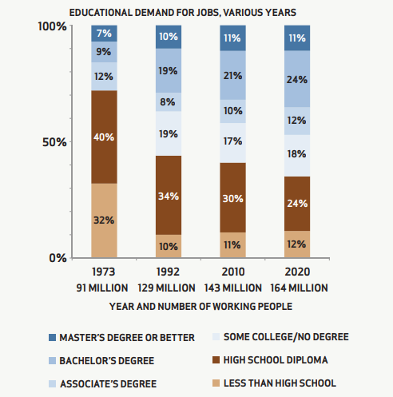

Slide 22
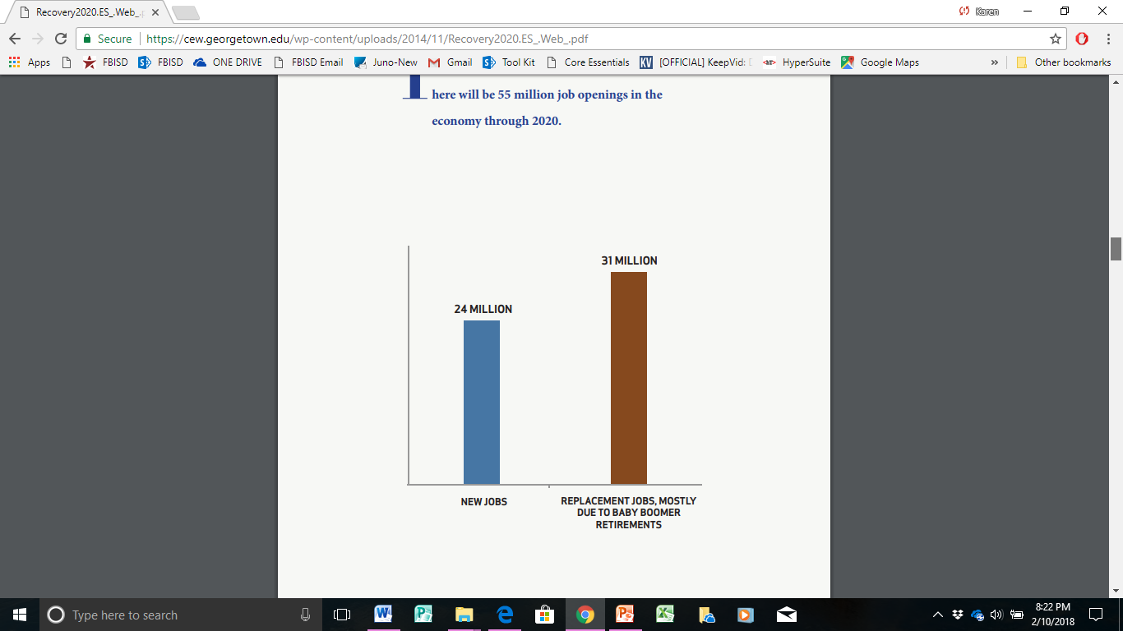
There will be 55 million job openings in the economy through 2020.

Slide 23
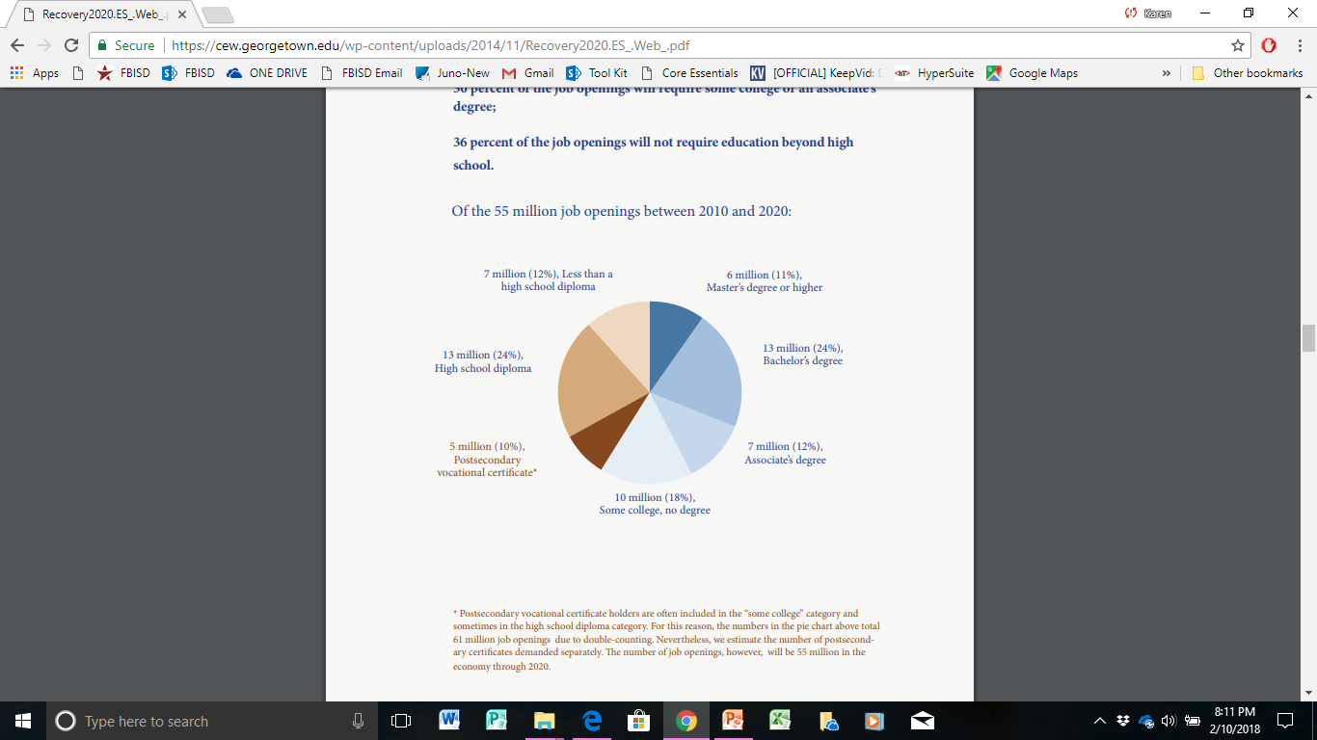
Georgetown University Studies

Slide 24
28% of College Freshman Who Took the ACT
Needed no remediation Freshman year in College
This means:
72% of College Freshman Were NOT Prepared for College Work!

Slide 25
Primary Reasons Why Students Drop Out of College
Lack of academic preparedness
Poor financial planning & difficulties of balancing work and college
A sense of not belonging; a sense of isolation, homesickness
Lack of parental support

Slide 26
Expectation
ALL students, regardless of their background and economic status, can become college and career ready
Research clearly shows that attaining proficiency in reading by 3rd grade is an indicator of future academic success.

Slide 27
Elementary schools create early awareness, knowledge, and skills that lay the foundation for the academic rigor and social development necessary for college and career readiness.
Teacher College Signs outside of classroom doors
College banners and pennants
Weekly College/Military Shirt Day
Career Day for PK-5th
College Visits – 3rd-5th
JA BizTown (interactive free-market lab)
Lay the foundation for middle & high school
Counselor’s website – career videos, interest inventories, etc.

Slide 28
Parent Guide to College & Career Readiness
Success in early reading & math: The student can read on grade-level and do grade-level math by the end of 3rd grade.
Personal Responsibility: The student exhibits good work habits. Help your child by increasing responsibility around the house and encouraging doing schoolwork.
Career Development Skills
  Awareness of the relationship between school and work.
  Skills to understand and use career information
  Awareness of the benefits of academic achievement.
  Awareness of different occupations and the changing gender roles.
  Awareness of the career planning process.

Slide 29
Parent Guide to College & Career Readiness
Interpersonal Skills: The student interacts positively with those around him/her. Help your child by exposing them to experiences that require that they work and play with others.
  Limit passive activities (electronics)
Decision Making: The student understands the decision-making process. Encourage your child to make decisions on their own. Possibly a small spending budget or organizing a family day out – anything that involves planning and choices.
Virginia Career VIEW/Virginia Tech/School of Education info@vaview.org

Slide 30
Parent Guide to College & Career Readiness
Create early awareness that connects academic performance - doing homework, coming to school on time, and habits as a learner (being helpful, having a positive attitude, listening and communicating) to getting better grades and attaining grade-level promotion.

Slide 31
Graduation Plans
Foundation Only – 22 credits-must wait until 10th grade with parent approval
Foundation + Endorsements – 26 credits –FBISD Default Plan
Distinguished Level of Achievement – 26 credits
Endorsements
Similar to a college major
Endorsement pathways are typically a sequence of courses for 4 credits
Within the Endorsement, student chooses a Pathway
Pathways – Refer to the online course selection guide

Slide 32
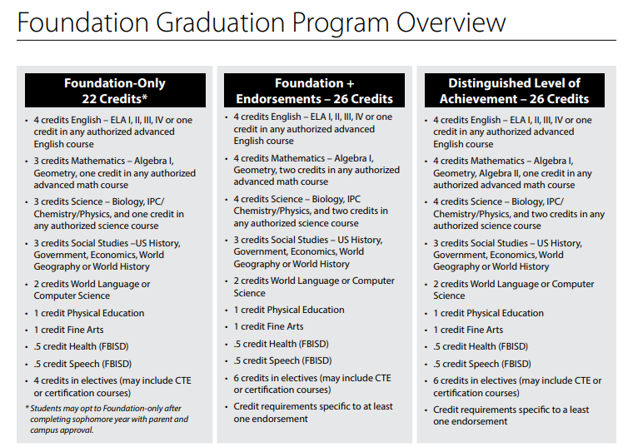

Slide 33
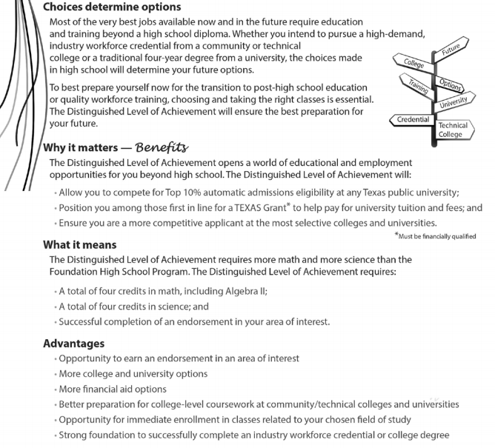
Distinguished Level of Achievement

Slide 34
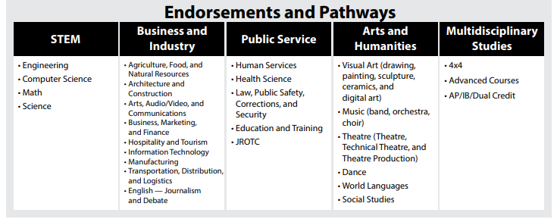


Slide 35
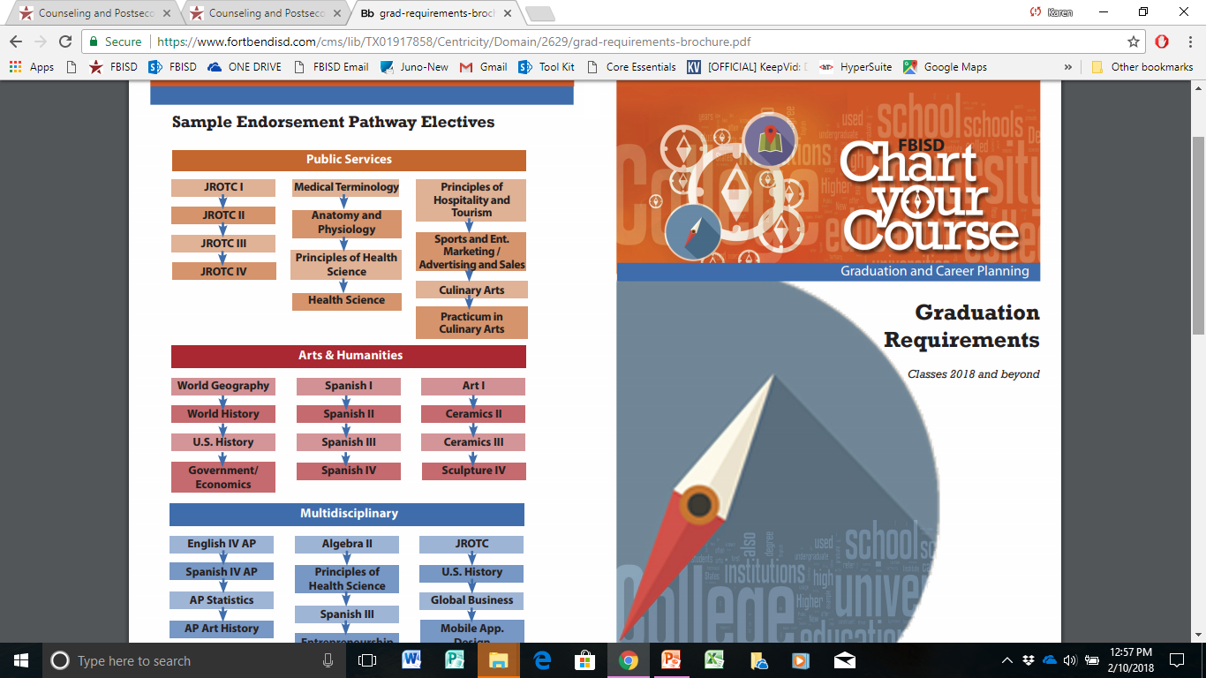

Slide 36
Programs of Study
16 Career Clusters
Agriculture
Architecture & Construction
Arts, Audiovisual & Communications
Automotive Technology
Business, Management & Administration
Construction, Cosmetology
Culinary Arts
Education & Training
Finance
Government & Public Administration
Health Science
Hospitality & Tourism
Human Services
Information Technology
Law, Public Safety, Corrections & Security
Manufacturing
Marketing, Sales & Services
Science, Technology, Engineering and Mathematics (STEM)
Transportation, Distribution & Logistics

Slide 37
AVID
Advancement Via Individual Determination, is a college readiness system for elementary through higher education that is designed to increase school-wide learning and performance.
The mission of AVID is to close the achievement gap by preparing all students for college readiness and success in a global society.
The AVID elective focuses on the least served students in the academic middle.
By raising expectations of students and, with the AVID support system in place, students rise to the challenge.
What distinguishes AVID from other educational reform programs is its continuous success rate.

Slide 38
Dual Credit
Eligible high school students are offered an opportunity to earn college credit while simultaneously completing high school requirements.
Credit is offered through Houston Community College.
Students must be College & Career Ready as proven by their TSI (Texas Success Initiative) score (SAT, ACT, STAAR EOC, PSAT, etc.)
Students must be assessed in reading, writing, and math skills prior to enrolling in college.
Dual credit include courses such as English, Pre-calculus, US History & Govt, Firefighting, Auto Mechanics, etc.
Courses are taken either at a high school or college campus

Slide 39
Dual Credit
The Benefits of Taking Dual Credit Classes
Saves money
Rigor
Jump start on degree
Students who take dual credit classes are more likely to continue in college after high school and graduate from college.

Slide 40
Advance & Pre-Advanced Courses (AP or Pre-AP)
The AP program allows high school students to participate in college level courses and possibly earn college credit while still in high school.
In May students have the opportunity to take the AP exam and if scoring a 3, 4, or 5 may be able to receive college credit for the course.
Pre-AP courses are available starting in the 6th grade-high school and are open to any student who is up to the challenge of these courses. These courses prepare students to take AP courses in 11th & 12th grade.
Pre-AP & AP courses require that students read and write extensively outside of class.

Slide 41
AP Courses
Students who complete AP & PRE-AP courses are:
Better prepared academically
More likely to specialize in more challenging majors
Likely to complete more college coursework in four years
Likely to perform significantly better in college than students who did not take AP courses
More likely to exercise leadership
More likely to graduate with a double major
Twice as likely to go into advanced study (Ph.D. programs, medicine, and law)
At an advantage for college admission

Slide 42
Naviance
Naviance is a comprehensive college and career readiness solution for middle and high school students, connecting academic achievement to post-secondary goals.
FBISD Department of Counseling and Post-Secondary Readiness.
  Click on Naviance
  Click on your middle school or high school
Student Shortcuts on Skyward Page

Slide 43
Weighted Grade Policy
100 Point Scale - Class of 2019-1st ones
10 extra points – AP Courses
5 extra points
  Pre-AP
  Honors Courses
  Dual Credit Courses
No extra points – On Level Courses

Slide 44
High School Grading System
Examples of a High School Student’s Grades
Physics (on level) 86 = 86 points
English III AP 94 = 104 points (10 additional points added for AP)
US History Dual Credit 84 = 89 points (5 additional points added for Dual Credit)
Athletics 100 = 100 points
Choir 100 = 100 points
Pre-Cal Pre-AP 86 = 91 (5 additional points added for Pre-AP)
Journalism 94 = 94
Total points = 664 points divided by 7 = 94.8571429

Slide 45
GPA Exempt Courses
GPA Exempt Courses for 3rd & 4th years (not included in GPA)
Athletics (not PE)
Band
Choir
Orchestra
Cheerleading
Color Guard
Debate
Dance
JROTC
Theatre
Agriculture
Advanced Journalism

Slide 46
Family Connection
Family Connection is a comprehensive web based tool that students use to create a post-secondary plan based on their passions and interests. Parents can partner with their student in the planning process.
Some planning activities include:
Self-assessments and interest inventories
Goal setting and creating future plans
Researching colleges
Researching careers
Searching for scholarship opportunities
Building a resume

Slide 47



Middle School Academies
GT Academy – GT Identified students apply in 5th grade
Notes:
We currently have six academies at 4 different high schools. They are the Digital Media Academy and the Medical Science Academy at Hightower High School, the Global Studies Academy and the International Business & Marketing Academy at Travis High School. The Engineering Academy at Elkins High School. And the Math and Science Academy at Dulles High School. As 8th graders, you will have the opportunity to apply to any, and/or all, of the academies listed here.

Slide 48
High School Academies
Open for 8th Grade Applicants
  Digital Media Academy (Hightower HS)
  Medical Science Academy (Hightower HS)
  Global Studies Academy (Travis HS)
  International Business & Marketing Academy (Travis HS)
  Engineering Academy (Elkins HS)
  Math & Science Academy (Dulles HS)
Notes:
We currently have six academies at 4 different high schools. They are the Digital Media Academy and the Medical Science Academy at Hightower High School, the Global Studies Academy and the International Business & Marketing Academy at Travis High School. The Engineering Academy at Elkins High School. And the Math and Science Academy at Dulles High School. As 8th graders, you will have the opportunity to apply to any, and/or all, of the academies listed here.

Slide 49
Apply at: secure.fortbendisd.com/academy
Opens in November for following year.
  Must apply to be considered – 8th grade
  One application - All six academies!
  Preview Nights at each campus during the month of October.
  Application due in February
Notes:
Once you have attended the Preview Nights and the Open Houses, you will be able to apply for admission into one or all six of the academies. Even if you do not attend the Preview Nights or the Open Houses, you can still apply.
There is one application for all six academies. During the application process you will determine how many and to which academies you would like to apply.
The application opens up the morning of November 1st and closes at 11:59 PM on November 30th. Be sure to get your application turned in on time. No late applications will be accepted.

Slide 50
What comes next?
  You receive a confirmation email for submission
  Your application gets validated
    STAAR, Residency, Grade Level
  If validated, you receive an email inviting you to
  an interview and/or exam
  If not validated, you receive notification of ineligibility

Slide 51
Interview: Required for DMA, GSA, IBMA
  Panel of 3 FBISD staff members
  5-7 minutes long
  First question will be sent via email
Exam: Required for EA, MSA, MedSci
  8th grade math skills, Algebra I
  40 questions
  1.5 hour testing window
Notes:
After you have successfully completed an application, you will be invited to attend one or both of the qualifying events.
The Digital Media Academy, the Global Studies Academy, and the International Business and Marketing Academy require that applicants complete an interview. The interview would last between 5 and 7 minutes and be in front of a panel of 3 FBISD staff members. Once you apply, and you are eligible for the interview, the first question of the interview will be sent to you via the email address that you supplied during the application process.
The Engineering Academy, the Math and Science Academy, and the Medical Science Academy require that applicants complete an exam. The exam is one and a half hours long and covers 8th grade math skills as well as some Algebra 1 skills. There are 40 questions on the exam.

Slide 52
General Requirements Once Accepted
  Minimum grade standards
    75 in academy courses
    70 in non-academy courses
  Four enrichment activities per academic year
  Total of 100 service hours
    Minimum of 25 hours per academic year until
    you reach 100
  Required course pathway each year
Let’s take a look at each one!
Notes:
Once you have been accepted into one of the academies, you will be held to a higher standard than other students.
We will expect you to maintain a 75 or above in your academy courses and a 70 or above in your non-academy courses.
We will expect you to complete four enrichment activities per academic year.
We will expect you to earn a minimum of 25 service hours per academic year until you reach a total of 100 service hours.
We will expect you to follow the required course pathway for your academy.

Slide 53

Top 3 Benefits
Digital Media Academy
  Small learning community with instructors from the industry
  Collaborate on hands-on projects with industry
  grade technologies
  Access to industry professionals
Notes:
Students in the Digital Media Academy have stated these to be the top 3 benefits to being in the Digital Media Academy.
The Digital Media academy students take digital media classes during their freshman and sophomore year. During their Junior Year, students specialize in either the Audio Visual track or the Graphic Design track.
________________________________________
Complete 6 Arts, Audio/Video and Communications credits in a coherent sequence as identified by the Digital Media Academy pathway on the campus.
2. Must be enrolled in preAP, AP, Honors or Dual Credit English all 4 years on the campus.
3. Must complete Computer Science 1 preAP.
4. Take and pass all appropriate course certifications.

Slide 54

Top 3 Benefits
Medical Science Academy
  Participate in hands-on hospital experiences
  Exposure to variety of professionals from the
  industry
  Participate in field experiences that develop your medical professional skills
Notes:
Students in the Medical Science Academy have stated these to be the top 3 benefits to being a member of the Medical Science Academy.
Students take General Medical science classes as Freshman and Sophomores and then can choose the Research Pathway or the Clinical Pathway in their Junior year.
________________________________________
1. Complete 5 Medical Science credits in a coherent sequence inclusive of Medical Terminology and Anatomy and Physiology as identified by the Medical Sciences Academy pathways on the campus.
2. Must be enrolled in preAP, AP, Honors or Dual Credit science all 4 years inclusive of Biology, Chemistry and Physics at the campus.
3. Take and pass all appropriate course certifications.
4. Participate in 4 pre-approved Medical Science activities annually.
5. Complete 100 hours of community service while enrolled in the Academy.

Slide 55

Top 3 Benefits
Global Studies Academy
  Earn travel grants for study abroad programs
  Participate in language, cultural, and political
  related activities
  Cross-curricular themed and co-horted classes, emphasizing project-based learning and leadership
  skills in a globalized world
Notes:
Students have stated these to be the top 3 benefits to being a Global Studies Student.
Students in the Global Studies Academy take 4 years of language, 4 years of English, and 4 years of Social Studies (including AP Human Geography, Global business, and the Academy Capstone course)
_________________________________
Required track: Levels I-IV of a language (start freshman year and continue until you complete level IV; Cohorted in PreAP ELA I-III, required ELA IV AP or Dual Credit, co-horted in World Geo PreAP and AP Human Geography; 5 total credits of Social Studies; Global Business; Senior year capstone
Partnerships with World Affairs Council of Houston, FBISD Extended Day, EF (travel); learn multiple languages, events are Global Issues Summit (student led summit each year); World business, Model UN; Student Lock-in; mentor program, Diplomat in Residence; Travel abroad (scholarship available); senior year capstone corse; tons of group volunteering events

Slide 56

Top 3 Benefits
International Business and Marketing Academy
  Earn industry certifications
  Participate in business and marketing related
  activities
  Compete in District, State, and National
  competitions
Notes:
Here are the top 3 benefits for the international business and marketing academy as told to us by their current students.
Students take business classes all four years, earning a total of 5 credits in business.
_________________
Required track: 5 business credits. Currently PBMF (9th), BIM (10th), Accounting (11th), Global Business/Advertising (11th), Business management OR Business law OR entrepreneurship OR practicum (12th grade); course industry certifications required
Activities IBMA does:
Rockets Marketing and Handouts; DECA competitions; HCC Teen Entrepreneur Summit; U of H Wolffest; Group Volunteer at Houston Foodbank, Buddy Walk, and other local events; college visits to school of business; guest speakers

Slide 57

Top 3 Benefits
Engineering Academy
  Work alongside and build inventions with practicing engineers
  Participate in engineering related activities
  Draft, develop, create, and test an invention, and its iterations.
Notes:
The top 3 benefits for being a student in the Engineering Academy are above.
Students take four Engineering Courses through Project Lead the Way ending with a capstone engineering course.
Required Track: Introduction to Engineering, Principles of Engineering, Civil Engineering and Architecture, Engineering Capstone
Partnerships with Texas Instruments, Lockheed Martin, Fluor, Alcon, BP, Systel, Inc., Vertical Automation, University of Houston, Rice, Baylor College of Medicine, City of Missouri City, and City of Sugar Land to provide internships, field trips, guest speakers, and other enrichment activities.
Students have the opportunity to participate in the Technology Student Association, Robotics Club, and Engineering Academy Officers organizations, as well as all of the other clubs and organizations at Elkins High School.

Slide 58

Top 3 Benefits
Math and Science Academy
  Work alongside and conduct research with
  practicing scientists, mathematicians, and engineers
  Participate in math and science related activities
  Compete on and with nationally and internationally ranked competitive academic teams
Notes:
The students in the Math and Science Academy have stated these to be the top 3 benefits to being in an academy.
Students are required to have 11 credits in math and science in a combination of 5 math and 6 science credits or 6 math and 5 science credits.
__________________________________
Required Track: Students are required to complete 11 math and science credits in a combination of 5 math/6 science or 6 math/5 science. Students will have the opportunity to take courses beyond the AP level in Biology, Chemistry, Physics, Math, and Computer Science.
Partnerships with Rice, University of Houston, Baylor College of Medicine, University of Texas at Austin, Texas A&M, Shell, NASA, and Showtime, to provide internships, field trips, guest speakers, and other enrichment activities.
Students have the opportunity to participate in the National Science Bowl, Mu Alpha Theta, UIL Academics, Academic Decathlon, Science National Honor Society, and Physics Bowl, as well as all of the other clubs and organizations at Dulles High School.

Slide 59
5 Pillars of College & Career Readiness
1. Personal Readiness-the character and quality that students need to be successful in life, both now and in their future endeavors
  organization, time management, perseverance, self-advocacy, social skills and leadership.

Slide 60
5 Pillars of College & Career Readiness
Students:
Make an action plan for your big future!
Work hard and develop habits to succeed now and in the future.
Develop daily routines for homework and stay organized.
Get involved in UIL and other extra-curricular activities to build social and leadership skills.
Find supportive adults at home, at school, or in your community to help you achieve your goals.
100 Community Service hours during high school
Never give up! There is nothing more important than character and perseverance.

Slide 61
5 Pillars of College & Career Readiness
2. Academic Readiness - preparing students for the academic challenge of college and careers. The AP program, Dual Credit opportunities, AVID program, and academies are district-wide activities that help support students' academic readiness.
Students:
Challenge yourself with Pre-AP and AP courses in your best subjects.
Earn college credit in high school with dual credit courses and by earning a 3 or better on AP Exams.
Take advantage of intervention, tutorial, and enrichment opportunities.

Slide 62
5 Pillars of College & Career Readiness
3. Career Readiness - the importance of all students from K-12th grade having systematic exposure to a wide variety of careers that are available and that match their passions and interests.
Elementary – Exposure to a wide variety of careers
Middle school and High school - students will narrow down their career aspirations and select a pathway or endorsement that will provide them with a sequence of courses to prepare them for their future career and college major.

Slide 63
Career Readiness
Students:
Choose your endorsement or Career and Technical Education (CTE) pathway of study and take the courses that will best prepare you for your future.
Take a practicum course at the end of your pathway and earn a professional certification while in high school.
Participate in job shadow opportunities.
Use elementary, middle and high school to learn about as many careers as possible.

Slide 64
Career & Technical Education (CTE)
FBISD’s Career and Technical Education (CTE) provides challenging career pathways for all students utilizing real world practices and evolving skill sets, attitudes, and behaviors.
Enable students to obtain certifications and gain entry-level employment in a high skill, high wage job and/or continue their education.
Programs of study include: Agriculture, Architecture, Arts, Audiovisual and Communications, Automotive Technology, Business and Industry, Construction, Cosmetology, Culinary Arts, Education and Early Childhood Training, Health Science, Information Technology, Law and Public Safety, Natural Resources; Robotics, and Science, Technology, Engineering and Mathematics (STEM),

Slide 65
Career & Technical Education (CTE)
Specific Programs
Automotive Technology/Maintenance
Diesel Equipment Technology
Energy & Natural Resource Technology
Oil & Gas Production
HVAC Systems
Plumbing
Electrical
Audio/Visual Production
Education Instructional Practices (Future Teachers/Child-Care)
First Aid, CPR
Health Science Practicum Experiences
Culinary Arts
Hotel Management
Travel & Tourism Management
Cosmetology
Computer Maintenance & Networking
Principals of Cybersecurity
Law Enforcement
Court Systems & Practices
Firefighter
Forensic Science
Welding

Slide 66
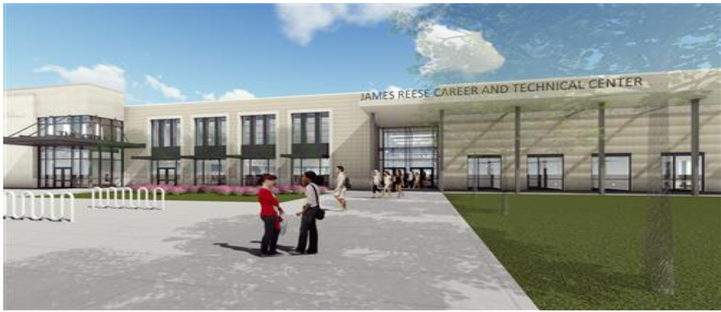
New CTE Facility
The new facility is located in Telfair; a 2-story building on 65 acres; cost of $60M.
Opening Fall of 2019.
2000 students vs 400 now. Half-Day Programs

Slide 67
New CTE Facility
Plans include five student-run enterprise businesses that will be open to the community, such as a full service restaurant and credit union.
Not just for High School Students
Elementary & Middle School students – field trips & district-wide programs
Beginning of Summer 2020 – Adults will be able to enroll in educational programs to advance their own interests and careers
Community Businesses will partner with the CTE

Slide 68



Slide 69
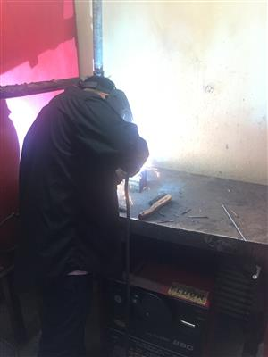


Slide 70
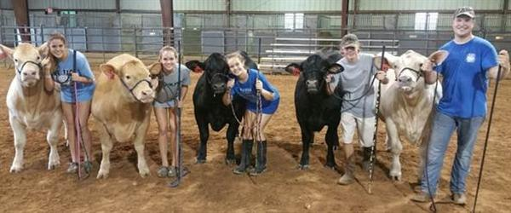
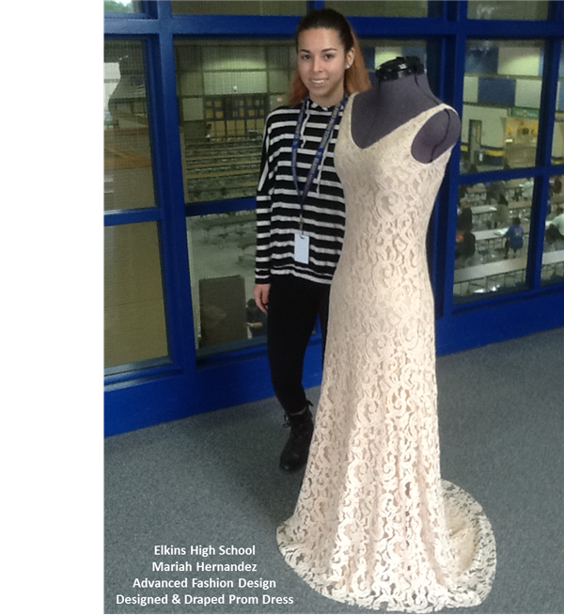


Slide 71
Military
Military - The military can offer a challenging and rewarding career option for students wanting to serve their country. There are multiple ways to pursue a military career.
Academies - A highly competitive educational institution which prepares candidates for service as an officer in the U.S. military. Academies cover all educational and living expenses in exchange for five years of military service as an officer after graduation. Selection into the Academies requires a congressional nomination, athletic ability, and high academic achievement. There are 5 U.S. Military Academies:
U.S. Air Force – Colorado Springs, CO
U.S. Coast Guard – New London, CT
U.S. Merchant Marine – Kings Point, NY
U.S. Military Academy – West Point, NY
U.S. Naval Academy – Annapolis, MD

Slide 72

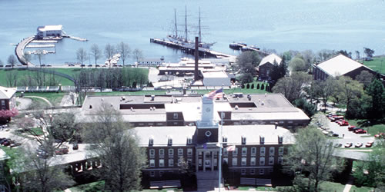
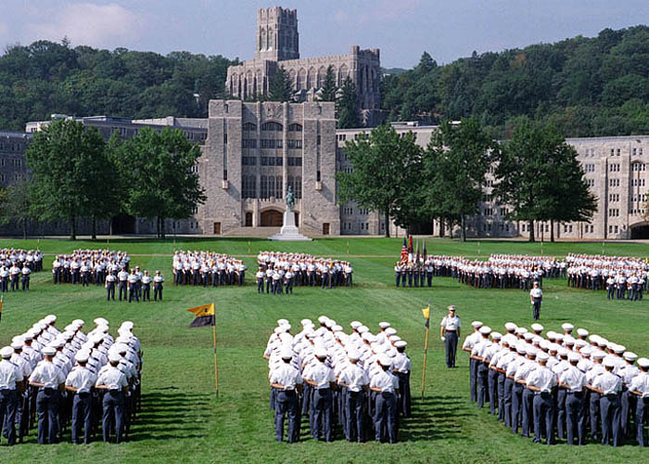
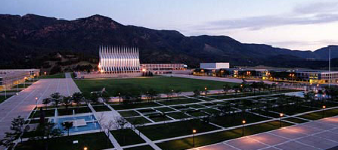
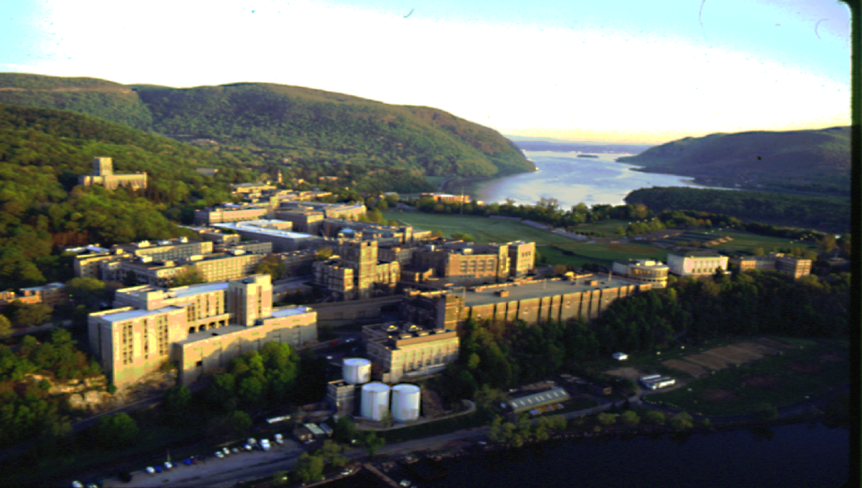
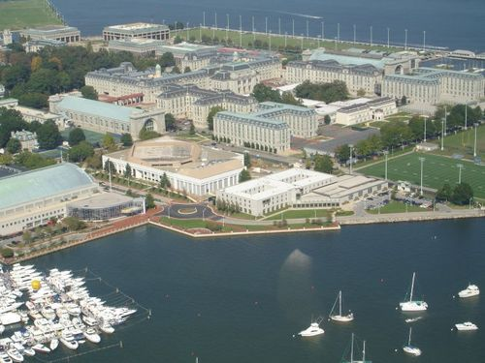
Five Academies to Consider
Air Force, Coast Guard, Merchant Marine, Naval & West Point
Notes:
The first point I want to make is that all five of these academies are as much yours as they are mine.
The second thing that is similar to all U.S. Service Academies is that they are very competitive. It is a competition to get in, and a competition to stay in. It should stand to reason that if you are seeking a scholarship that is worth more than $200,000 that some work is required.
This leads me to my third point, and that admission to any of the service academies requires a lot of work.

Slide 73
Basic Requirements
Legal Requirements:
  17-22 years old
  United States Citizen
  Unmarried
  Not pregnant; with no legal obligation to support a child
  MMA accepts 17-25
Leadership
  Demonstrated leadership in school, community, church,
  scouts, etc.
Academic Qualifications:
  Above average High School or College academic record
  Strong performance on ACT/SAT
Medical Qualifications:
  Good physical and mental health
  Pass a Qualifying Medical Exam
Physical Qualifications:
  Above average strength, endurance, and agility
  Good performance on Candidate Fitness Assessment
Notes:
The legal requirements for admission to USMA, USNA, and USAFA can be found in Title 10 United States Code, legal requirements for admission to the USCGA can be found in Title 14 United States Code, and legal requirements for admission to USMMA can be found in Title 46 United States Code.
All the academies are looking for leaders.
All the academies are looking for scholars who know how to learn.
The Medical Exam is a complete medical exam not a sports physical and is paid for by the respective service academy that you are applying to but scheduled by you with a doctor contracted to conduct these exams in the local area.
Will we talk about the Candidate Fitness Assessment used by all academies in a little bit.

Slide 74
Evaluation Process
Academic
  High School Rank
  SAT and/or ACT
  Transcript
Leadership
  Extracurricular Activities
  Athletic Participation
  Faculty Appraisals
Timed tests only
ACADEMIC
ABILITY
60%
LEADERSHIP
POTENTIAL
30%
CADET
CANDIDATE
FITNESS
ASSESSMENT
10%
Notes:
28
Here is the breakdown of the whole candidate score. High School Rank is an indicator of competitiveness. SATs and ACTs level the playing field. Your transcripts reflect the courses you have taken, the grades you have received, and your class rank. With respect to extracurricular activities, you do not need so many that you spread yourself too thin, the object is to demonstrate leadership. Every cadet or midshipmen is an athlete whether you are on a NCAA team, in a club sport like Rugby, or on an intramural team.
Before the end of your Junior year, identify three teachers; English teacher, Math teacher, and a Science teacher of a science with a laboratory period, and get their contact information. Trying to get these folks over the summer may be a real challenge. Provide that information to the academy and the academy will contact them.
Check with the reps on how this is done for their academy. Also check with the Congressman’s office and see what they require for letters of recommendation.
With respect to the Candidate Fitness Assessment, you do not need to MAX it, but if you do poorly on it and fail it, you are disqualified as a candidate.

Slide 75
Evaluation Process
Candidate Fitness Assessment (CFA)
Basketball throw
Pull-ups
Shuttle run
Modified sit-ups
Push-ups
One mile run
MMA and CGA - Physical Fitness Exam (PFE)
Push Ups
Sit-Ups
1.5 Mile Run
Notes:
Except where indicated, the Candidate Fitness Assessment is used for most academies and accounts for 10% of your Whole Candidate Score. It will be one test you will get where you know the answers ahead of time, so study and practice this and do not do “Discovery Learning” on the day you decide to take this for record. A rundown of the events is as follows;
Basketball throw on your knees. It is a test of upper body strength and when you are on your knees, you can not use your hips as much to help you throw. Use an overhand throw, no side-armed throw.
Pull-ups. Females have the option of Flexed Arm Hang, but I can tell you that one pull-up will count for more than a max effort on the flexed arm hang!
Shuttle run. Down and back, down and back on a 30’ foot course. Practice the turns, hand and foot over the line on each turn.
Modified sit-ups. Knees bent with arms across the chest.
Push-ups is push-ups.
One mile run is one mile run.
You don’t have to max it, but don’t flunk it or you are done!

Slide 76
II’m a Junior in High School…What is the next step?
’m a Junior in High School…What is the next step?
Go online an open a file in January with the academies of your choice
Send in standardized scores for SAT and/or ACT with writing portion
Send in Sports and Activities
Apply for Summer Leader Experience OR visit your Academy
Get contact information for Math, English, and Science Teacher
Get contact information for Lead Counselor or Registrar
In May go online and open a file with appropriate elected officials
Practice the Candidate Fitness Assessment for the academy/academies
of your choice
Apply for and attend Boys State/Girls State

Slide 77
Final Thoughts
Remember, Admission to a Service Academy is Competitive!
Start Early! Explore the admissions websites.
Determine if an academy is right for you!
Consider Senior ROTC and ROTC Scholarships in college
Prepare Academically
Academies “Super Score” SATs and ACTs
Take tests early and often, use march2success.com
Get involved in sports and extracurricular activities
Be an Athlete! (Prepare Physically!)
Be a Leader!
Visit the Academies.
Summer Leader Experience
During the school year
Virtual tour

Slide 78
Military
Reserve Officer Training Corps (ROTC) - A college-based program for training commissioned officers of the United States armed forces. The ROTC offers a scholarship that helps with educational expenses. Check university ROTC websites for details. Each military branch has their own ROTC scholarship page (Navy, Army, Air Force)
  ROTC starts in Middle School (JROTC)
Enlisting - Enlisting in active duty of the military (Navy, Army, Air Force, Coast Guard, National Guard, or Marines) or in the reserves requires a commitment for 4-6 years.
Armed Services Vocational Aptitude Battery (ASVAB) - This test has questions that are similar to the SAT and ACT, but is broader in assessing possible career readiness skills.

Slide 79
5 Pillars of College & Career Readiness
4. Admissions Readiness -ensure that all students are prepared to enter the postsecondary training or career of their choice. Sophomores and juniors take the PSAT and participate in other test prep opportunities.
Students:
Maintain a high grade point average and class rank.
Take the PSAT seriously and use My College QuickStart to help prepare for the SAT and ACT.
Get to know the College & Career Resource Advisor at your high school's College & Career Resource Center.

Slide 80
5 Pillars of College & Career Readiness
5. Financial Readiness -provides awareness and critical support to enable all students to access their future.
FBISD provides parent workshops on financial aid and scholarships.
Advisors are available to help parents complete their Free Application for Federal Student Aid (FAFSA) along with district-wide FAFSA completion events where professional tax help is available.
FBISD Parent University (Departments-Counseling & Postsecondary Readiness)

Slide 81
Financial Readiness
Students:
Don't let money keep you from pursuing your dreams.
Learn about and apply for scholarships. FBISD seniors earn millions of dollars in scholarships every year. This could be you!
Fill out and complete your Free Application for Federal Student Aid (FAFSA) in October and definitely by March of your senior year.
Take advantage of FAFSA Workshops that take place around the district and Houston. Free professional help is available.

Slide 82
Paying for College
Financial Aid
Everyone qualifies for some form of financial aid.
FREE assistance is available for filing the FAFSA and interpreting results
FAFSA opens October 1st of each year
Can now use previous year’s tax return
Beware of Scams! FAFSA.com is NOT a government agency. Always go to FAFSA.gov

Slide 83
Paying for College
Financial Aid
Financial aid comes from the federal and local government. It's money that helps a student pay for education expenses.
Federal student aid covers expenses such as tuition and fees, room and board, books and supplies, and transportation.
Financial aid often comes in the form of grants, loans, and work-study.
Grants – do not have to be paid back; based on financial need
Loans – most have to be paid back
Work-Study-on/off campus job usually 10-20 hours/week. You still have to apply for the job. It is not a guarantee.
JOB – Work your way through school.

Slide 84
Financial Aid
Grants – Examples
Texas Equalization Grant (State) – allows students with financial need to attend a private college/university
Teach Grant (Federal) - $4,000/year in exchange for teaching 4 years at a Title 1 school
Pell Grant (Federal) – Need-based
Federal Supplemental Educational Opportunity Grant (SEOG) – Exceptional need
Texas Public Educational Grant (TPEG)
TEXAS Grant – Need-based financial aid to Texas Students

Slide 85
Scholarships
Scholarships
  Free money, but there may be a few strings attached (e.g. good academic standing). In the end, the benefits of scholarships far outweigh any negatives you might attribute to the process in obtaining and/or maintaining the award.
  Free money for good ACT & SAT scores
  Colleges have renewable academic scholarships
  Merit Based (Academic, Class rank or GPA, Test Scores)
  Special Skills (Music, Drama, Athletics, Art)
Always talk to the financial aid officer at the college to make sure you are getting all the help you can.

Slide 86
College Savings Plans
Texas Tuition Promise Fund – Prepaid Tuition Plan
Texas College Savings Plan – Direct-Sold College Savings Tax-advantage Plan (529)
LoneStar 529 Plan – Advisor-Sold College Savings Tax-advantage Plan

Slide 87
Financial Aid - Federal Loans
  Federal Stafford Loans
    Subsidized Stafford – based on financial need; government pays the interest while student is in school
    Unsubsidized Stafford -not based on financial need; student is only charged interest while in school which he/she can pay while in school or let it accumulate (it will be added to the amount of the loan).
    Repayment starts 6 months after graduation or dropping below full-time status. No credit check required.

Slide 88
Financial Aid - Federal Loans
  Perkins Loans
    Need-based; subsidized.
    Awarded by the college to students with the greatest need.
    No payments made while in school
    Debt may be forgiven if student enters a career in public service, such as teaching.

Slide 89
Financial Aid - Federal Loans
  Parent Plus Loans
    Parent borrows money for dependent child’s education
    Loan-repayment starts 60 days after disbursement – Parent responsible for repayment; Deferrable
    Credit check required

Slide 90
Financial Aid - State Loans
  State Loans - Usually not subsidized nor need-based
    Texas B-on-time Loan (BOT) – 0% interest; can be forgiven if graduate on time with a B average or better. Currently available for renewals only.
    College Access Loans (CAL) - www.hhloans.com
  TAFSA (Texas Application for State Financial Aid)
      If you are a foreign student or non-citizen, you may be eligible to be classified as a Texas resident for tuition purposes.
      Qualifies a student for State Financial Aid. Resident status is based on the student, not the parent.

Slide 91
Financial Aid – Private Loans
  Private Student Loans
    Not subsidized
    Credit unions; Banks
    Parent may need to co-sign loan
  College-sponsored Loans
    Money loaned comes directly from the college

Slide 92
Financial Aid – Private Loans
Other Loan - Private organizations & Foundations
  Abe & Annie Seibel Foundation
      0% loan
      Not based on need
      Must start paying immediately ($50/month); have 7 years after graduation to pay it back. Can borrow up to $6,000 per year up to 4 years.
      Need 2 co-signers (not living in same house)
  Minnie Stevens Piper Foundation Compendium
    4% interest loan
    Can borrow up to $10,000

Slide 93
Financial Aid – Private Loans
  Home-equity Loans-loan against the equity in your house
Loans have various repayment terms and some offer deferments.

Slide 94
Funding College
College Savings Plans
Texas Tuition Promise Fund-Prepaid Tuition Plan. Lock in today’s tuition rates for future use
Texas College Savings Plan – Direct-Sold College Savings tax-advantage Plan
LoneStar 529 Plan – Advisor-Sold College Savings tax-advantage Plan
Texas Match the Promise Foundation Scholarships & Grants
  Will match a portion of your contributions
  Students apply in 5th-9th grade
  Family income - $100,000 or less
Texas ABLE Program 529A –Savings program for individuals with disabilities.

Slide 95
Helpful Websites
www.Collegeforalltexans.com
www.Everychanceeverytexan.org
Google - state grant programs
www.scholarshipmonkey.com
www.unigo.com (scholarships)
Achieve Texas – https://issuu.com/achievetexas
www.Scholarships.com
Fastweb – https://www.fastweb.com
Fortbendisd.com
  Departments
    Counseling and Postsecondary Readiness

Slide 96
Career Information
Counselor Website
  FBISD – School – Student & Parents – Counseling - Resources
Resources
  Link to College & Career Workshop Power Point
  Short Career videos in English & Spanish
  Personality Types
  Salary Calculator
  Career Exploration
  Skill Assessment
  Financial Aid - FAFSA

Slide 97
Sources
FBISD Website – Departments of Counseling & Post-Secondary Readiness and Advanced Academics
2016 Congressional Guide-Admission to U.S. Service Academies
Utah Valley University – Brent Burnham
CollegeBoard Advocacy & Policy Center
Virginia Career VIEW/Virginia Tech/School of Education; info@vaview.org
U.S. Department of Labor Statistics

